Slide 1

Chapter 6
Delivery, Forwarding,
and Routing of IP Packets
Objectives
Upon completion you will be able to:
Understand the different types of delivery and the connection
Understand forwarding techniques in classful addressing
Understand forwarding techniques in classless addressing
Understand how a routing table works
Understand the structure of a router

Slide 2
6.1 DELIVERY
The network layer supervises delivery, the handling of the packets by the underlying physical networks. Two important concepts are the type of connection and direct versus indirect delivery.
The topics discussed in this section include:
Connection Types
Direct Versus Indirect Delivery

Slide 3

Note:
IP is a connectionless protocol.

Slide 4
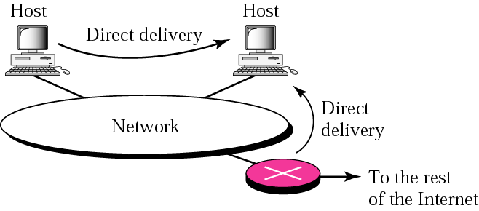
Figure 6.1 Direct delivery

Slide 5
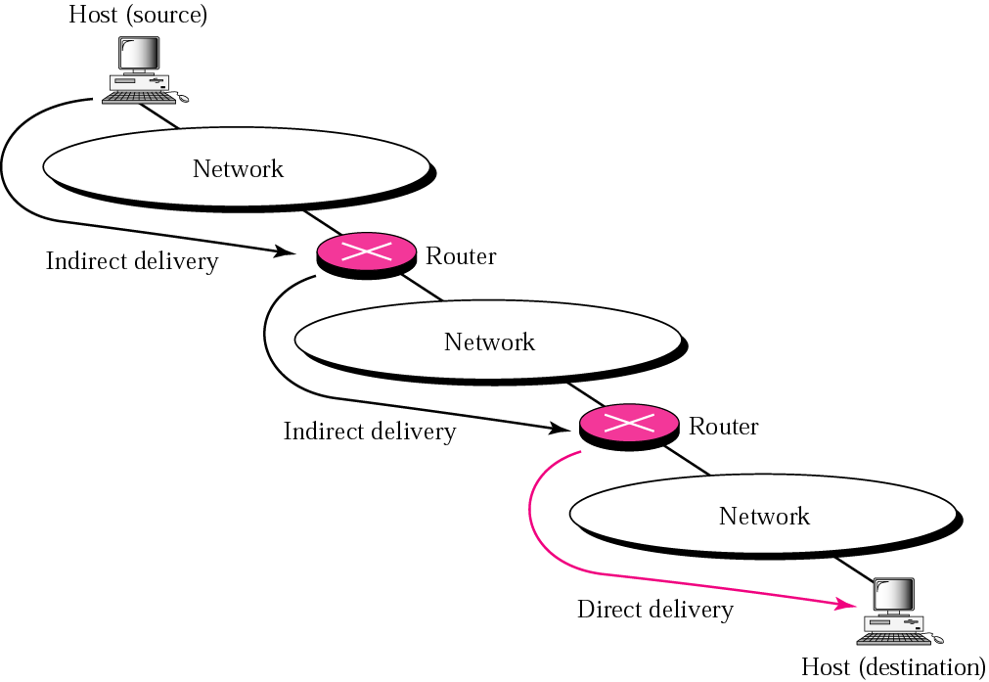
Figure 6.2 Indirect delivery

Slide 6
6.2 FORWARDING
Forwarding means to place the packet in its route to its destination. Forwarding requires a host or a router to have a routing table. .
The topics discussed in this section include:
Forwarding Techniques
Forwarding with Classful Addressing
Forwarding with Classless Addressing
Combination

Slide 7
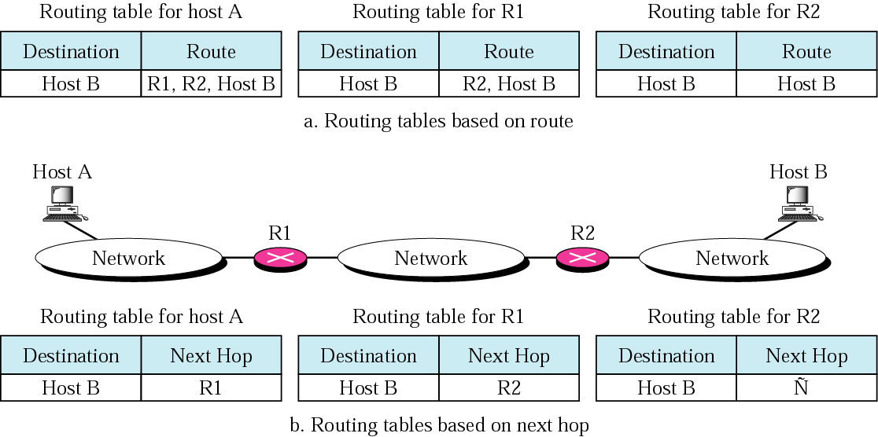
Figure 6.3 Next-hop method

Slide 8
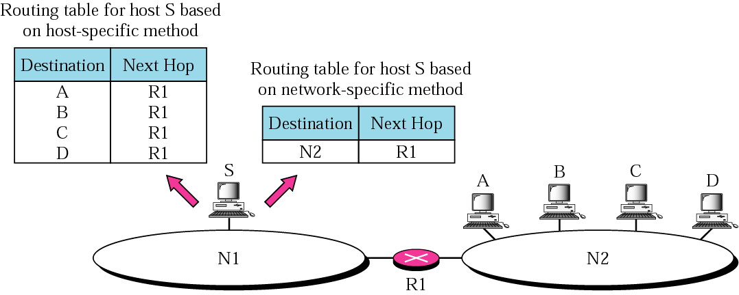
Figure 6.4 Network-specific method

Slide 9
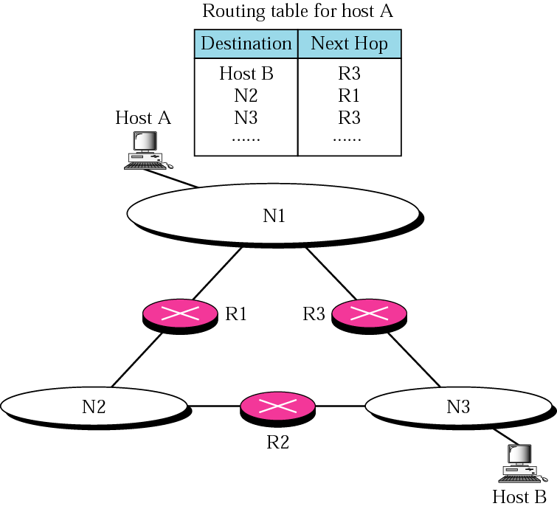
Figure 6.5 Host-specific routing

Slide 10
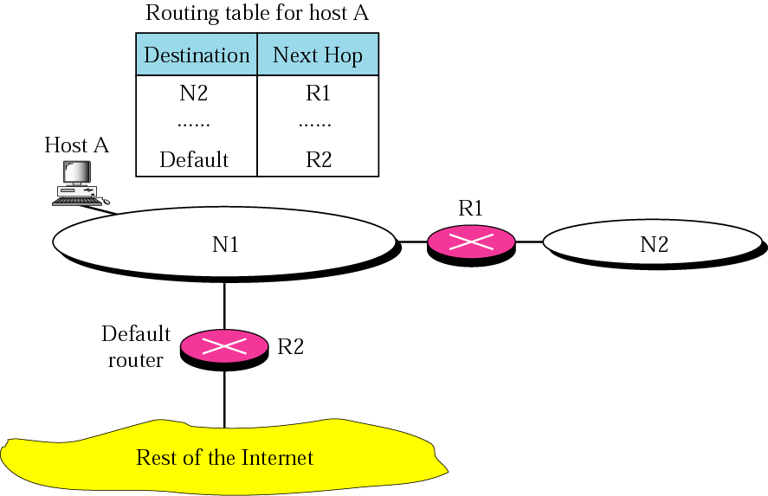
Figure 6.6 Default routing

Slide 11
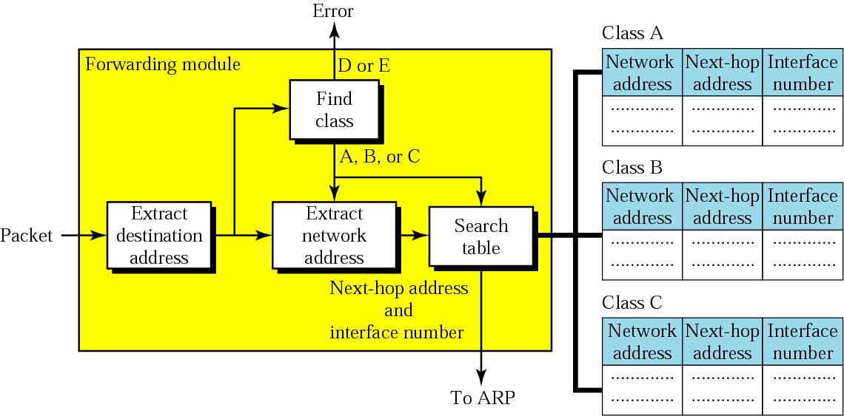
Figure 6.7 Simplified forwarding module in classful address without subnetting

Slide 12
Example 1
Figure 6.8 shows an imaginary part of the Internet. Show the routing tables for router R1.
See Next Slide

Slide 13
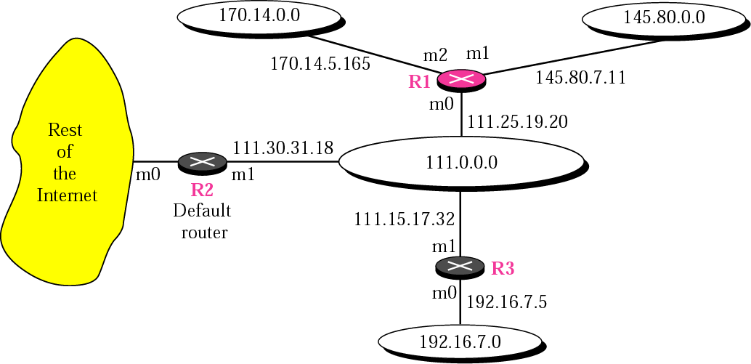
Figure 6.8 Configuration for routing, Example 1

Slide 14
Example 1 (Continued)
Solution
Figure 6.9 shows the three tables used by router R1. Note that some entries in the next-hop address column are empty because in these cases, the destination is in the same network to which the router is connected (direct delivery). In these cases, the next-hop address used by ARP is simply the destination address of the packet as we will see in Chapter 7.
See Next Slide

Slide 15
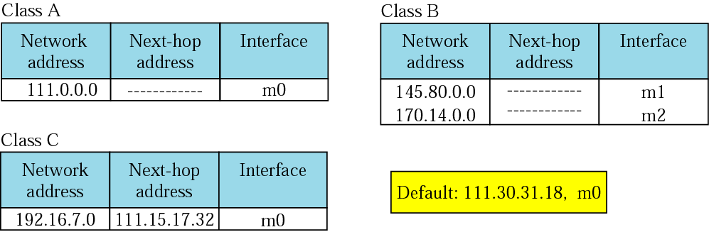
Figure 6.9 Tables for Example 1

Slide 16
Example 2
Router R1 in Figure 6.8 receives a packet with destination address 192.16.7.14. Show how the packet is forwarded.
Solution
The destination address in binary is 11000000 00010000 00000111 00001110. A copy of the address is shifted 28 bits to the right. The result is 00000000 00000000 00000000 00001100 or 12. The destination network is class C. The network address is extracted by masking off the leftmost 24 bits of the destination address; the result is 192.16.7.0. The table for Class C is searched. The network address is found in the first row. The next-hop address 111.15.17.32. and the interface m0 are passed to ARP.

Slide 17
Example 3
Router R1 in Figure 6.8 receives a packet with destination address 167.24.160.5. Show how the packet is forwarded.
Solution
The destination address in binary is 10100111 00011000 10100000 00000101. A copy of the address is shifted 28 bits to the right. The result is 00000000 00000000 00000000
00001010 or 10. The class is B. The network address can be found by masking off 16 bits of the destination address, the result is 167.24.0.0. The table for Class B is searched. No matching network address is found. The packet needs to be forwarded to the default router (the network is somewhere else in the Internet). The next-hop address 111.30.31.18 and the interface number m0 are passed to ARP.

Slide 18
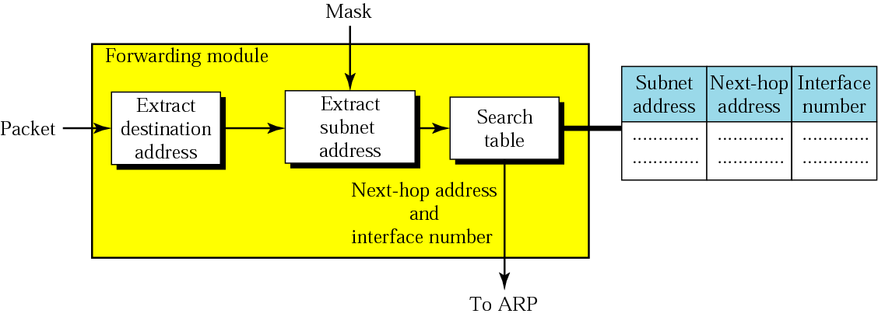
Figure 6.10 Simplified forwarding module in classful address with subnetting

Slide 19
Example 4
Figure 6.11 shows a router connected to four subnets.
See Next Slide

Slide 20
Example 4 (Continued)
Note several points. First, the site address is 145.14.0.0/16 (a class B address). Every packet with destination address in the range 145.14.0.0 to 145.14.255.255 is delivered to the interface m4 and distributed to the final destination subnet by the router. Second, we have used the address x.y.z.t/n for the interface m4 because we do not know to which network this router is connected. Third, the table has a default entry for packets that are to be sent out of the site. The router is configured to apply the mask /18 to any destination address.

Slide 21
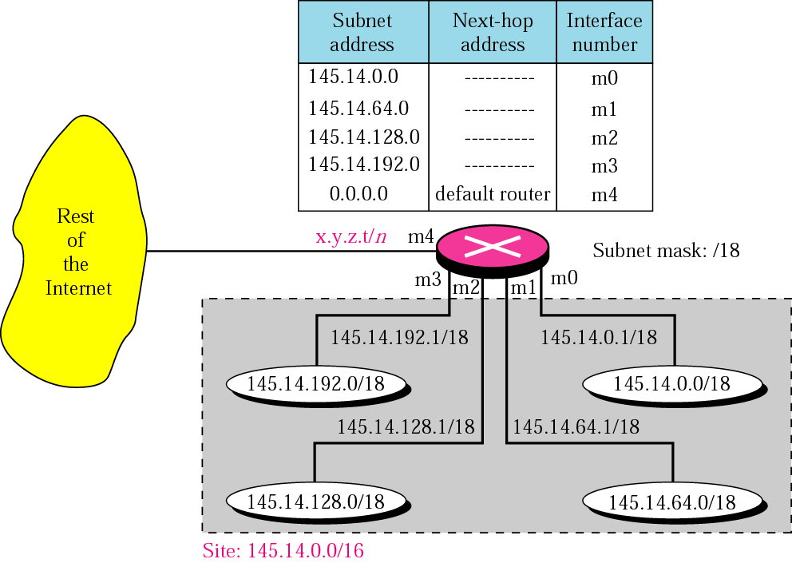
Figure 6.11 Configuration for Example 4

Slide 22
Example 5
The router in Figure 6.11 receives a packet with destination address 145.14.32.78. Show how the packet is forwarded.
Solution
The mask is /18. After applying the mask, the subnet address is 145.14.0.0. The packet is delivered to ARP with the next-hop address 145.14.32.78 and the outgoing interface m0.

Slide 23
Example 6
A host in network 145.14.0.0 in Figure 6.11 has a packet to send to the host with address 7.22.67.91. Show how the packet is routed.
Solution
The router receives the packet and applies the mask (/18). The network address is 7.22.64.0. The table is searched and the address is not found. The router uses the address of the default router (not shown in figure) and sends the packet to that router.

Slide 24
Note:
In classful addressing we can have a routing table with three columns;
in classless addressing, we need at least four columns.

Slide 25
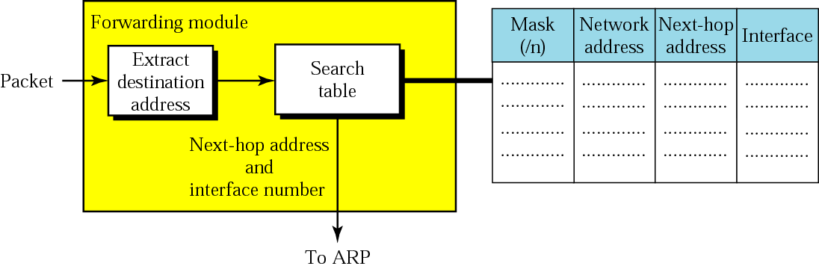
Figure 6.12 Simplified forwarding module in classless address

Slide 26
Example 7
Make a routing table for router R1 using the configuration in Figure 6.13.
See Next Slide
Solution
Table 6.1 shows the corresponding table.
See the table after the figure.

Slide 27
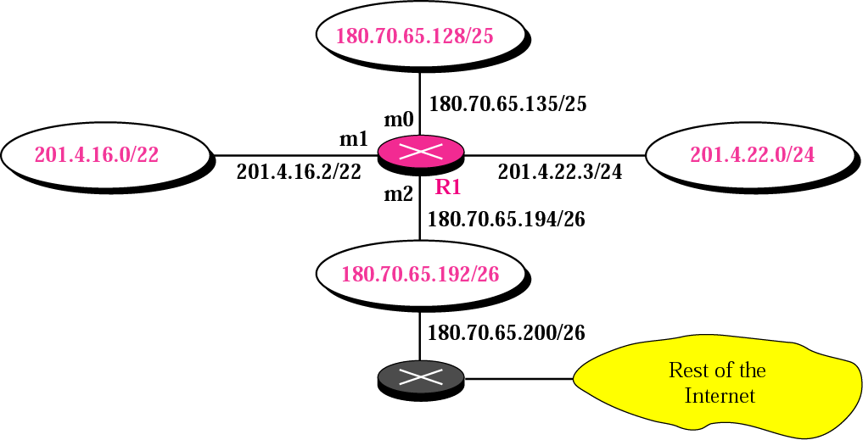
Figure 6.13 Configuration for Example 7

Slide 28
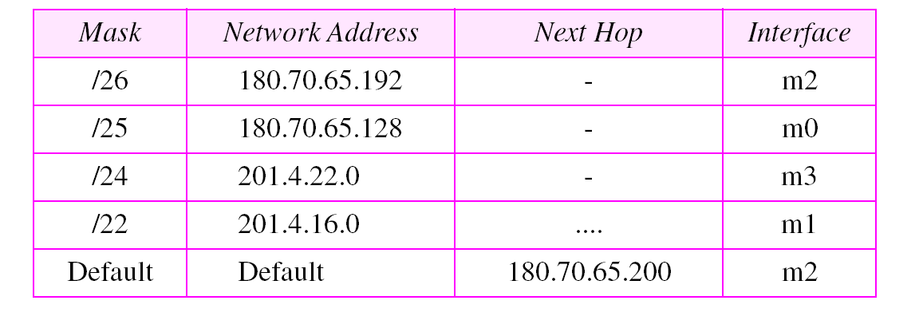
Table 6.1 Routing table for router R1 in Figure 6.13

Slide 29
Example 8
Show the forwarding process if a packet arrives at R1 in Figure 6.13 with the destination address 180.70.65.140.
Solution
The router performs the following steps:
1. The first mask (/26) is applied to the destination address. The result is 180.70.65.128, which does not match the corresponding network address.
See Next Slide

Slide 30
Example 8 (Continued)
2. The second mask (/25) is applied to the destination address. The result is 180.70.65.128, which matches the corresponding network address. The next-hop address (the destination address of the packet in this case) and the interface number m0 are passed to ARP for further processing.

Slide 31
Example 9
Show the forwarding process if a packet arrives at R1 in Figure 6.13 with the destination address 201.4.22.35.
Solution
The router performs the following steps:
See Next Slide

Slide 32
Example 9 (Continued)
1. The first mask (/26) is applied to the destination address. The result is 201.4.22.0, which does not match the corresponding network address (row 1).
2. The second mask (/25) is applied to the destination address. The result is 201.4.22.0, which does not match the corresponding network address (row 2).
3. The third mask (/24) is applied to the destination address. The result is 201.4.22.0, which matches the corresponding network address. The destination address of the package and the interface number m3 are passed to ARP.

Slide 33
Example 10
Show the forwarding process if a packet arrives at R1 in Figure 6.13 with the destination address 18.24.32.78.
Solution
This time all masks are applied to the destination address, but no matching network address is found. When it reaches the end of the table, the module gives the next-hop address 180.70.65.200 and interface number m2 to ARP. This is probably an outgoing package that needs to be sent, via the default router, to some place else in the Internet.

Slide 34
Example 11
Now let us give a different type of example. Can we find the configuration of a router, if we know only its routing table? The routing table for router R1 is given in Table 6.2. Can we draw its topology?
See Next Slide

Slide 35
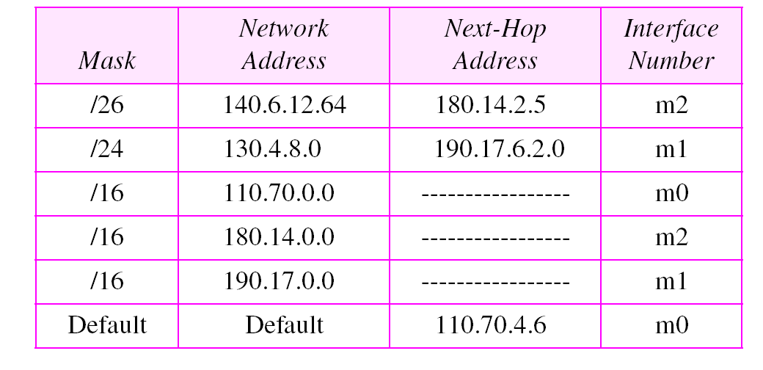
Table 6.2 Routing table for Example 11

Slide 36
Example 11
(Continued)
Solution
We know some facts but we don’t have all for a definite topology. We know that router R1 has three interfaces: m0, m1, and m2. We know that there are three networks directly connected to router R1. We know that there are two networks indirectly connected to R1. There must be at least three other routers involved (see next-hop column). We know to which networks these routers are connected by looking at their IP addresses. So we can put them at their appropriate place.
See Next Slide

Slide 37
Example 11 (Continued)
We know that one router, the default router, is connected to the rest of the Internet. But there is some missing information. We do not know if network 130.4.8.0 is directly connected to router R2 or through a point-to-point network (WAN) and another router. We do not know if network140.6.12.64 is connected to router R3 directly or through a point-to-point network (WAN) and another router. Point-to-point networks normally do not have an entry in the routing table because no hosts are connected to them. Figure 6.14 shows our guessed topology.
See Next Slide

Slide 38
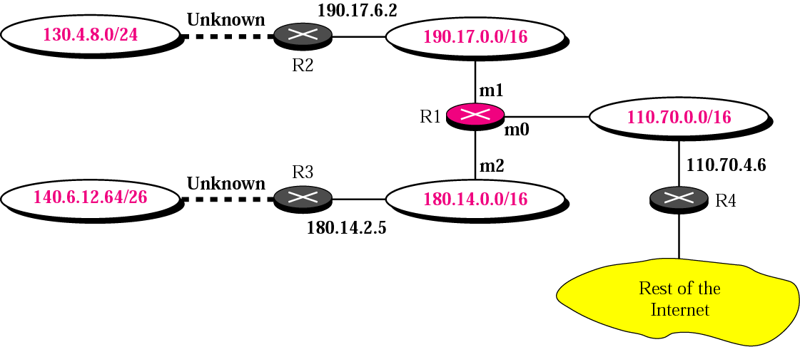
Figure 6.14 Guessed topology for Example 6

Slide 39
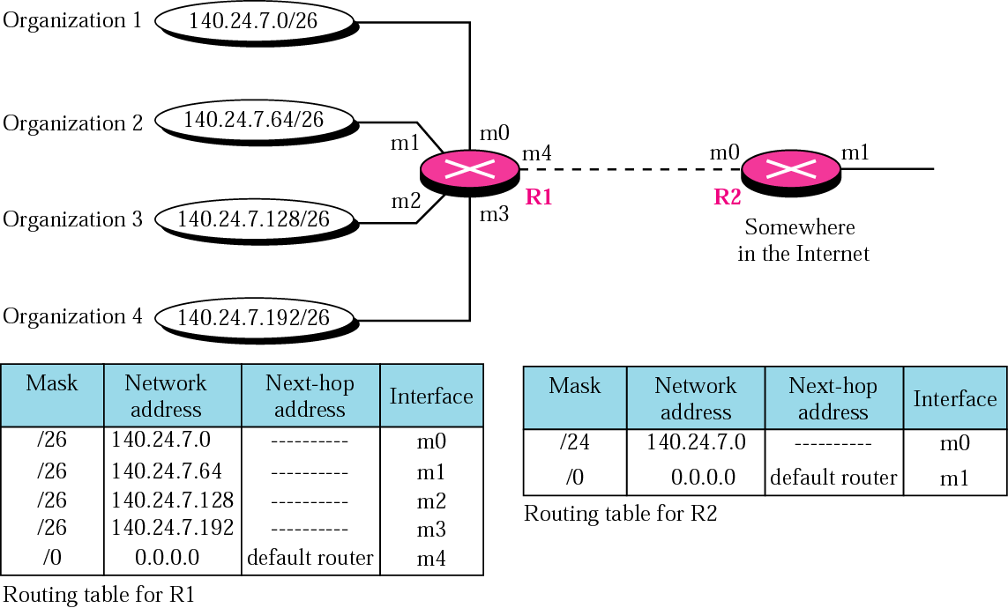
Figure 6.15 Address aggregation

Slide 40
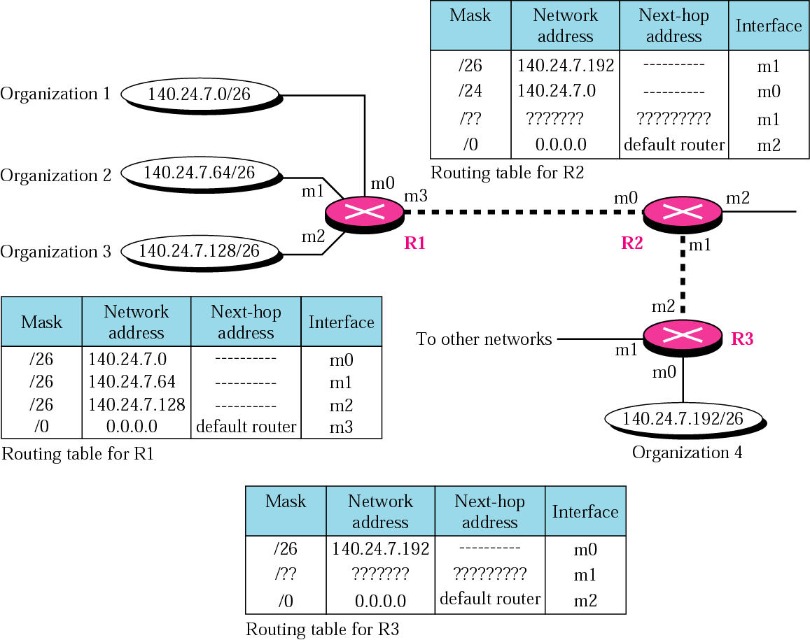
Figure 6.16 Longest mask matching

Slide 41
Example 12
As an example of hierarchical routing, let us consider Figure 6.17. A regional ISP is granted 16384 addresses starting from 120.14.64.0. The regional ISP has decided to divide this block into four subblocks, each with 4096 addresses. Three of these subblocks are assigned to three local ISPs, the second subblock is reserved for future use. Note that the mask for each block is /20 because the original block with mask /18 is divided into 4 blocks.
See Next Slide

Slide 42
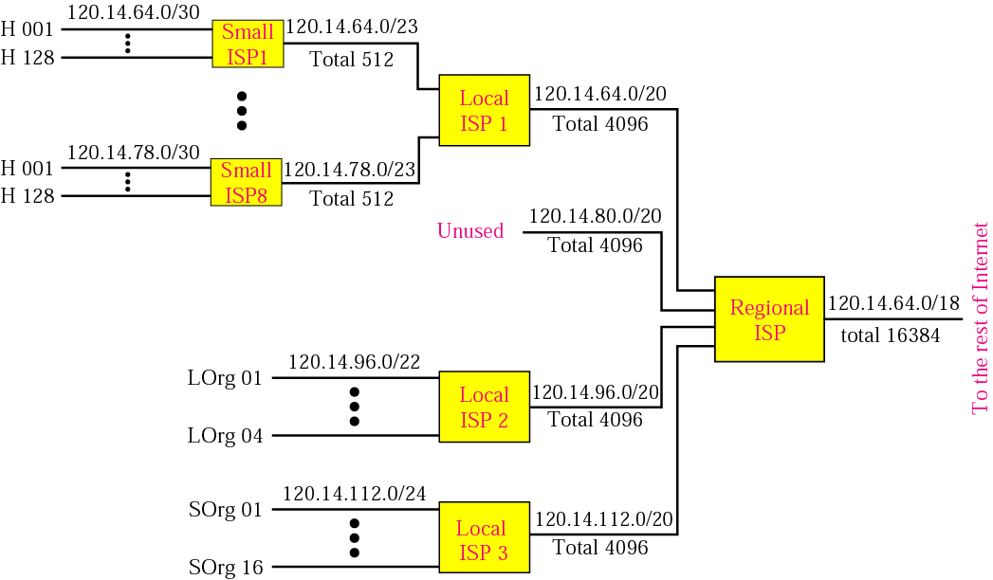
Figure 6.17 Hierarchical routing with ISPs

Slide 43
Example 12 (Continued)
The first local ISP has divided its assigned subblock into 8 smaller blocks and assigned each to a small ISP. Each small ISP provides services to 128 households (H001 to H128), each using four addresses. Note that the mask for each small ISP is now /23 because the block is further divided into 8 blocks. Each household has a mask of /30, because a household has only 4 addresses (2³²⁻³⁰ is 4).
The second local ISP has divided its block into 4 blocks and has assigned the addresses to 4 large organizations (LOrg01 to LOrg04). Note that each large organization has 1024 addresses and the mask is /22.
See Next Slide

Slide 44
Example 12 (Continued)
The third local ISP has divided its block into 16 blocks and assigned each block to a small organization (SOrg01 to SOrg15). Each small organization has 256 addresses and the mask is /24.
There is a sense of hierarchy in this configuration. All routers in the Internet send a packet with destination address 120.14.64.0 to 120.14.127.255 to the regional ISP. The regional ISP sends every packet with destination address 120.14.64.0 to 120.14.79.255 to Local ISP1. Local ISP1 sends every packet with destination address 120.14.64.0 to 120.14.64.3 to H001.

Slide 45
6.3 ROUTING
Routing deals with the issues of creating and maintaining routing tables.
The topics discussed in this section include:
Static Versus Dynamic Routing Tables
Routing Table

Slide 46
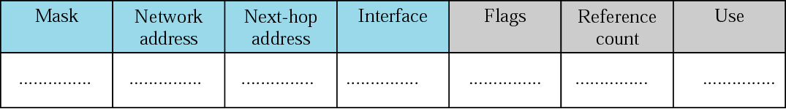
Figure 6.18 Common fields in a routing table

Slide 47
Example 13
One utility that can be used to find the contents of a routing table for a host or router is netstat in UNIX or LINUX. The following shows the listing of the contents of the default server. We have used two options, r and n. The option r indicates that we are interested in the routing table and the option n indicates that we are looking for numeric addresses. Note that this is a routing table for a host, not a router. Although we discussed the routing table for a router throughout the chapter, a host also needs a routing table.
See Next Slide

Slide 48
Example 13 (continued)
$ netstat -rn
Kernel IP routing table
Destination Gateway Mask Flags Iface
153.18.16.0 0.0.0.0 255.255.240.0 U eth0
127.0.0.0 0.0.0.0 255.0.0.0 U lo
0.0.0.0 153.18.31. 254 0.0.0.0 UG eth0.
See Next Slide

Slide 49
Example 13 (continued)
More information about the IP address and physical address of the server can be found using the ifconfig command on the given interface (eth0).
$ ifconfig eth0
eth0 Link encap:Ethernet HWaddr 00:B0:D0:DF:09:5D
inet addr:153.18.17.11 Bcast:153.18.31.255 Mask:255.255.240.0
....
From the above information, we can deduce the configuration of the server as shown in Figure 6.19.
See Next Slide

Slide 50
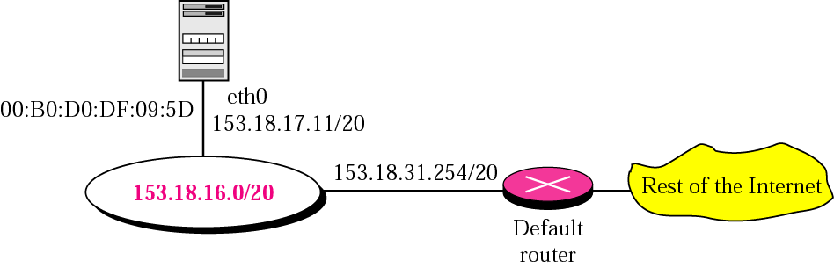
Figure 6.19 Configuration of the server for Example 13

Slide 51
6.4 STRUCTURE OF A ROUTER
We represent a router as a black box that accepts incoming packets from one of the input ports (interfaces), uses a routing table to find the departing output port, and sends the packet from this output port.
The topics discussed in this section include:
Components

Slide 52
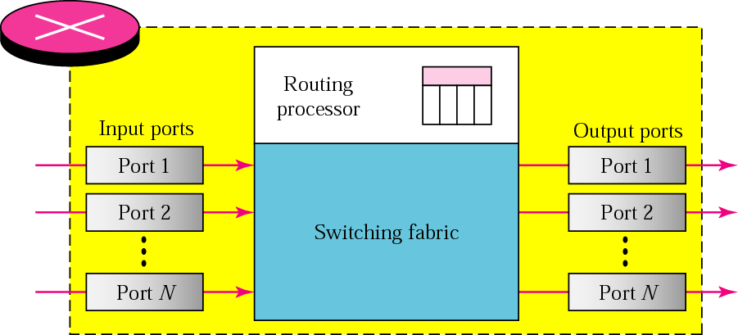
Figure 6.20 Router components

Slide 53
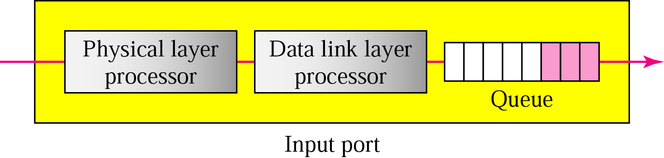
Figure 6.21 Input port

Slide 54
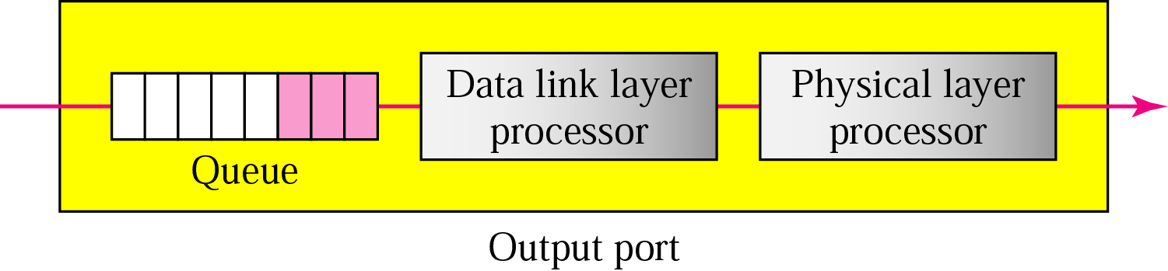
Figure 6.22 Output port

Slide 55
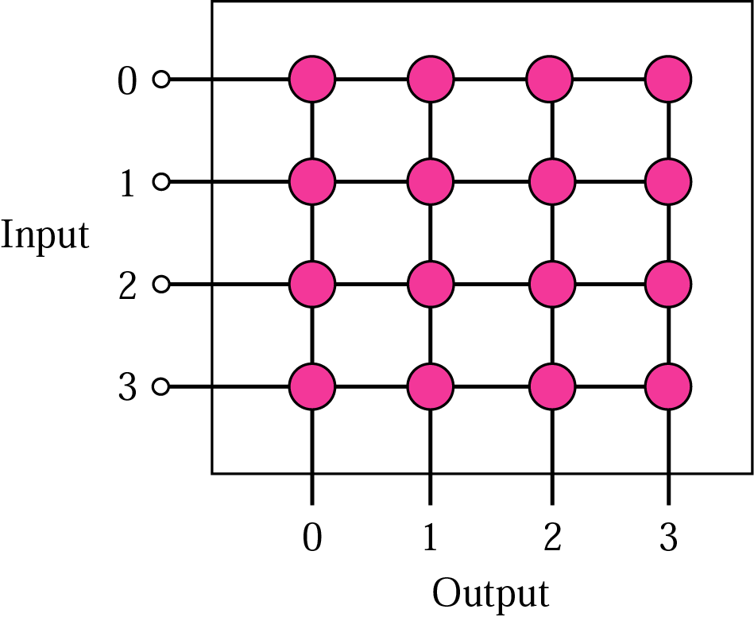
Figure 6.23 Crossbar switch

Slide 56
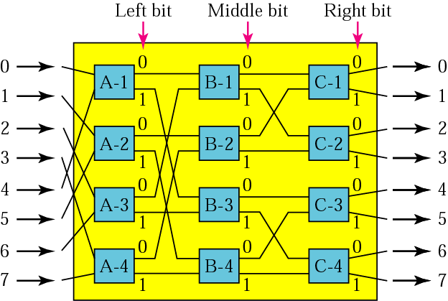
Figure 6.24 A banyan switch

Slide 57
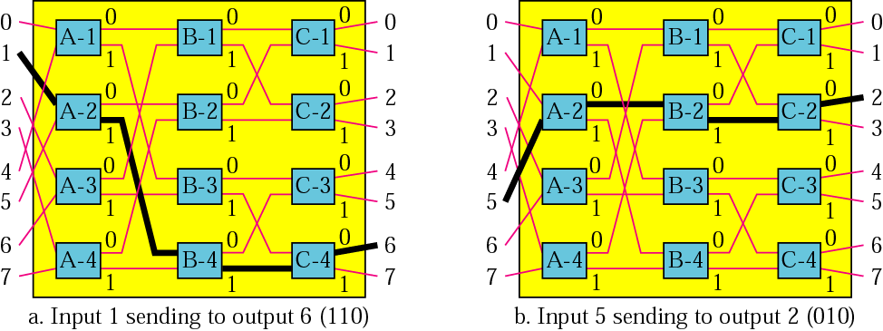
Figure 6.25 Examples of routing in a banyan switch

Slide 58
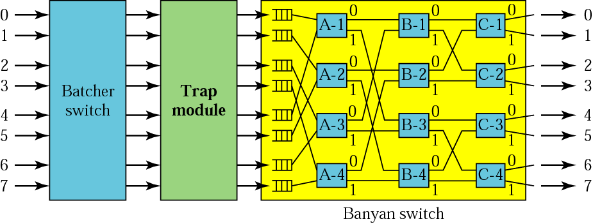
Figure 6.26 Batcher-banyan switch

